Slide 1
Restaurant Delivery Website Proposal
Josh Pahang
Mar. 4, 2025

Slide 2
Background
Brief Overview:
Client seeks to implement an online delivery system for his restaurant.
Problem:
His current website is not up-to-date on current technologies, and boosting his website with an online delivery system will help boost customer engagement.

Slide 3
Client Goals
Home Menu | Food Menu Page
Address/Location Entry | Order Pick-Up and Take-Out Page
Search Functionality | Item Cart
Payment Window | Order Confirmation and Tracking
Customer Profile and Account Management | Notification and Alert System
Review and Feedback System | Promotions and Rewards System
Customer Support | Order Customization
Delivery Zone Management | Reorder Past Orders

Slide 4






Proposed Solutions & Limitations
No-Code CMS (WordPress + WooCommerce)
Quick and fast implementation.
Easy to manage
Limited customization
Custom Code CMS (React + Node.js)
Highly customizable
More complex to develop and maintain
Third-Party Integrations (DoorDash/UberEATS)
Outsources delivery management
Limited control and requires fees

Slide 5
Features & Prioritization
High Priority
Home Menu, Food Menu Page, Address/Location Entry, Order Page, Item Cart, Payment Processing, Order Confirmation and Tracking
Medium Priority
Search Functionality, Customer Profile and Account Management, Notification and Alert System, Review and Feedback System, Loyalty Program, Customer Support
Low Priority
Delivery Zone Management, Reorder Past Orders

Slide 6
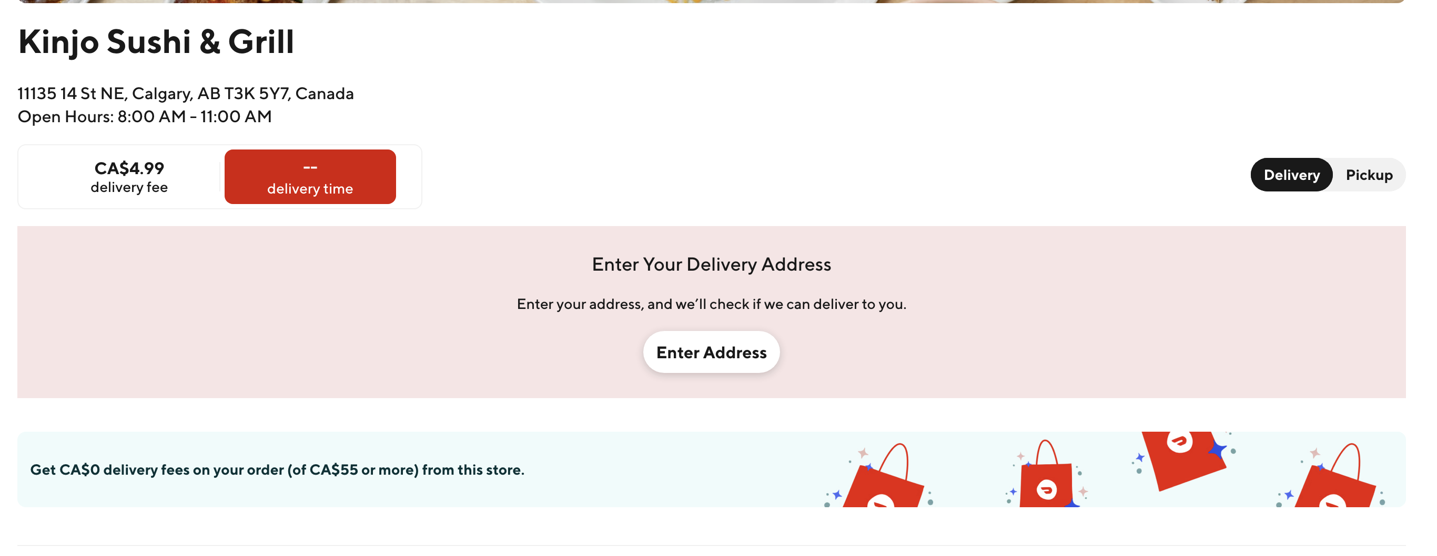
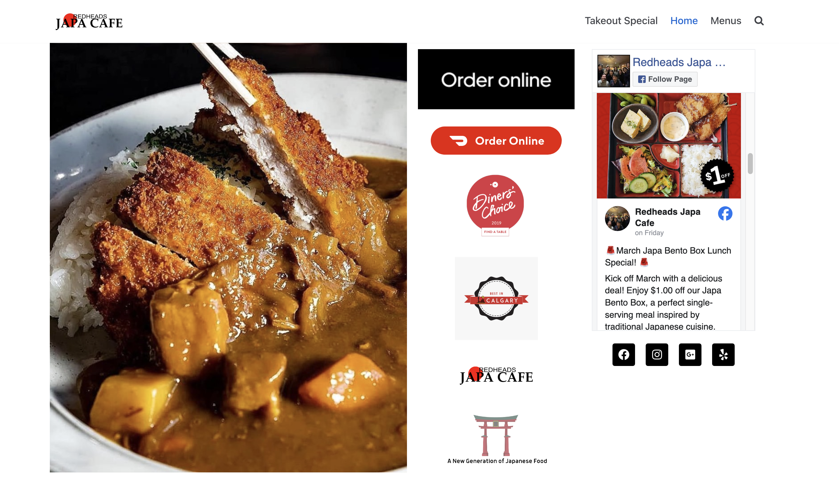
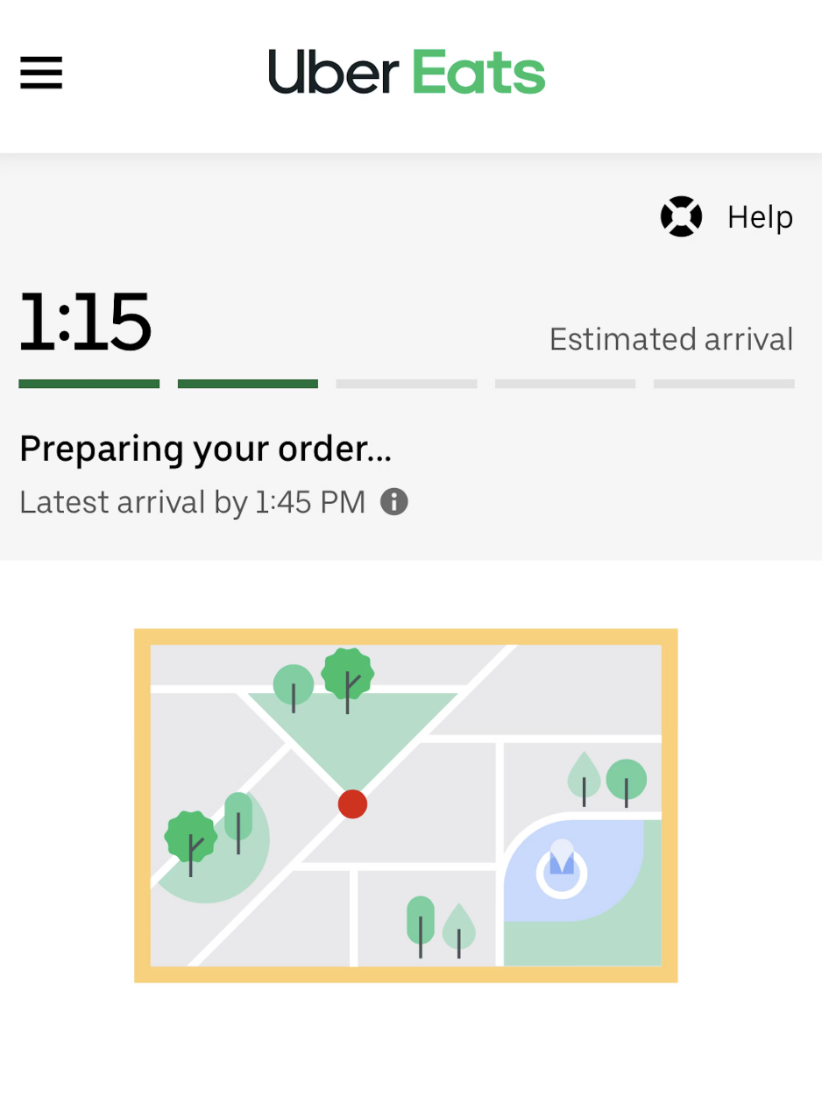
Examples

Slide 7

Time Estimates
Initial UI/UX Design & Wireframing ~ 20 hours
Database & Backend Setup ~ 25-30 hours
Frontend Development ~ 40-50 hours
Integrating a Payment Gateway ~ 10-15 hours
Testing and Debugging ~ 20-30 hours
Launch and Post-Launch Support ~ 10 hours
Overall: ~ 3-4 Weeks for full development

Slide 8

Q&A
Any Comments, Questions, or Concerns?

Slide 9
LET’S GET IT DONE
THANK YOU

